Slide 1

EBMcalc and EBMcalc FHIR® Edition
System Build
Quality Assurance

Slide 2
Calculator Accuracy and Precision
Reliable calculator function is rooted in the simplicity of our source files, and the sophistication of our custom build engine.
No server interaction or network connectivity is required to run calculations once built as dynamic HTML.
Source file curation and build engine functionality have steadily matured through 20 years of development. This creates reliable consistency in all calculator builds.
Steady and valuable feedback from our partners and individual users has been an enduring asset.

Slide 3
Calculator Accuracy and Precision
Our Single Source File Rule:
All calculator build types such as Basic, EHR connect, Lab connect, Spreadsheet, Optimization, Handheld, Tablet, and Patient view calculators are built from a single, simple source file.

Slide 4
New Calculator Build
Must be based in Evidence-based medicine (EBM).
Original journal articles containing potential new calculators are reviewed by our medical director.
Once approved, a new calculator source file is created and built.
Builders test calculators with test parameters to assure exact calculation.
Medical director reviews new calculator build to assure it matches the functionality specified in associated EBM literature resource.

Slide 5
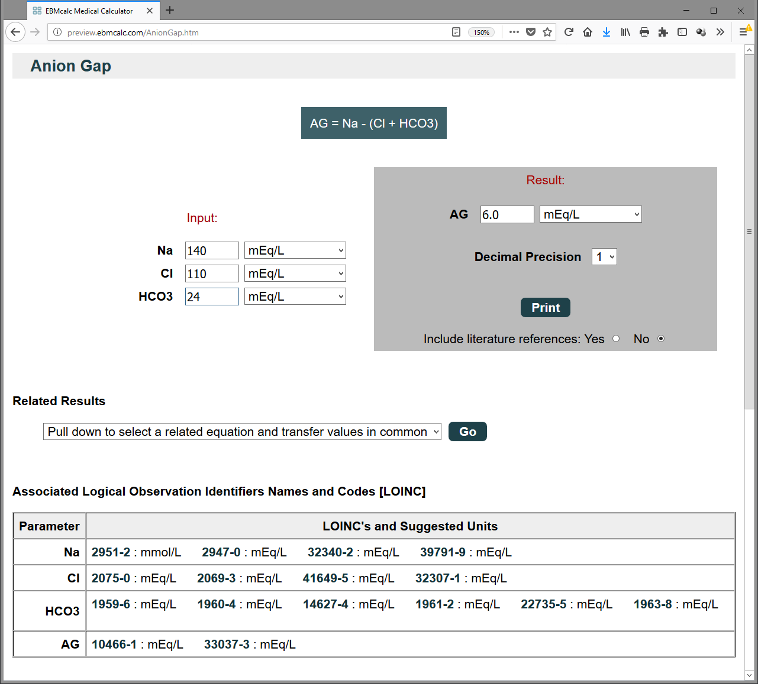
New Calculator Build
Example of source file simplicity: AnionGap.eq
e|Anion Gap|Renal; Fluid; Electrolytes; Metabolism; Emergency|87|pub|276.2 Acidosis; 775.7 Late metab acidosis nb
eq|AG = Na - (Cl + HCO3)|mEq/L
p|Na|mEq/L||80|200
p|Cl|mEq/L||60|180
p|HCO3|mEq/L
Builds AnionGap.htm:
For internal calculator consistency all source file equations and parameters are used both in the HTML presentation and in the underlying JavaScript.

Slide 6
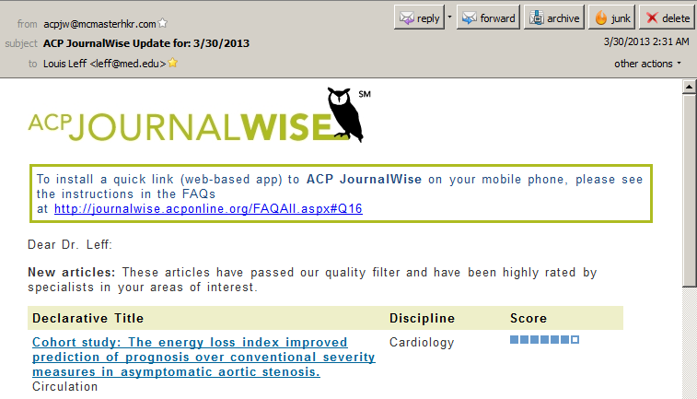
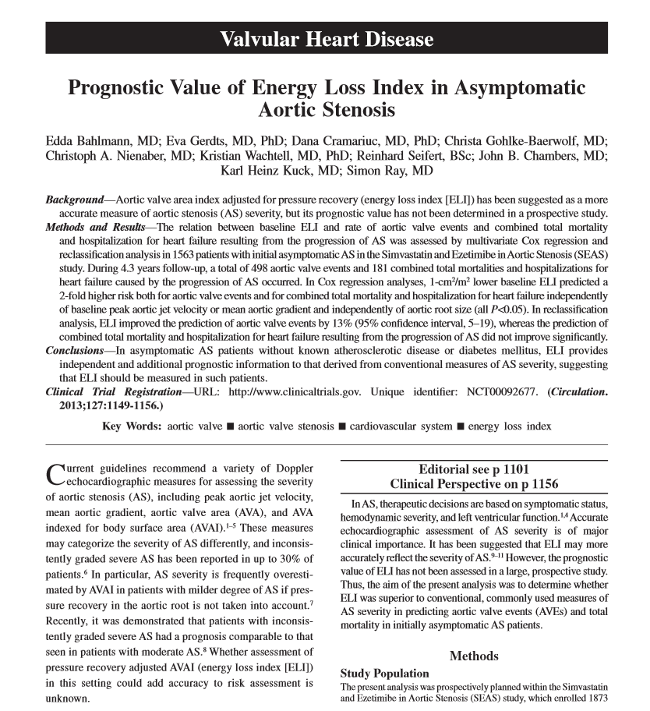
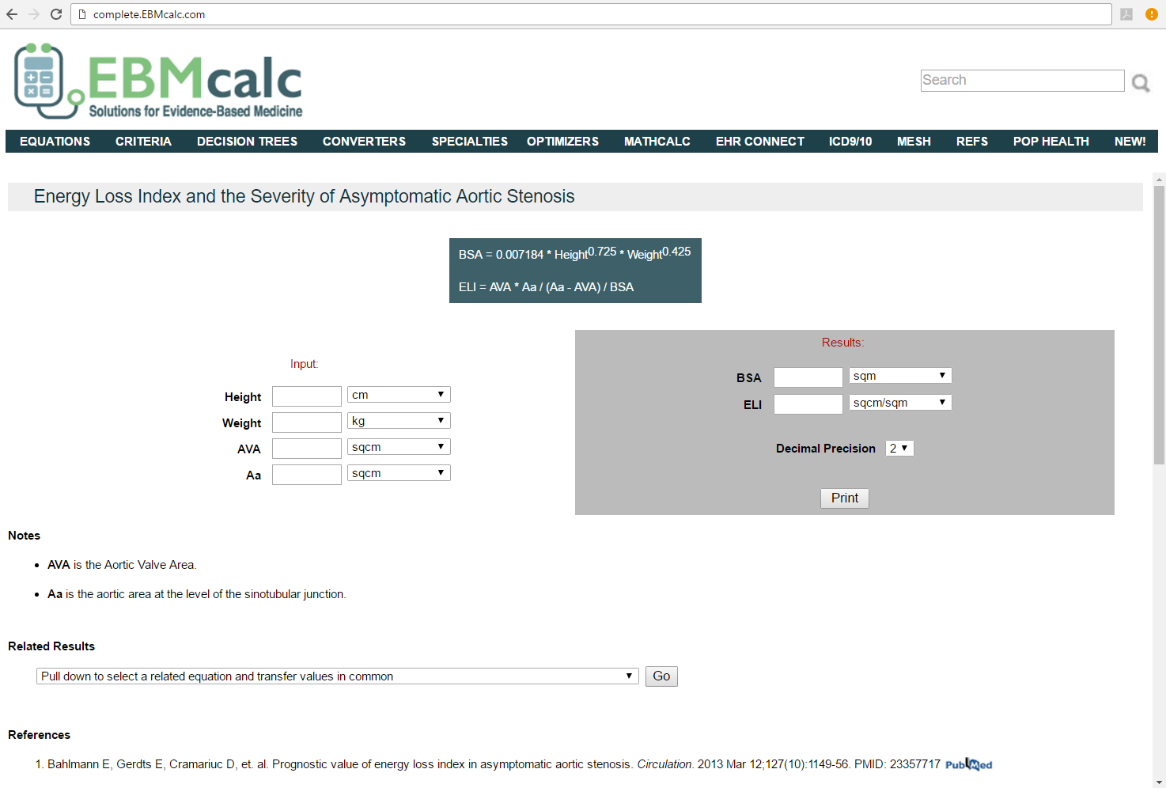
EBMcalc Responsiveness
Request to product
creation in
1 week

Slide 7
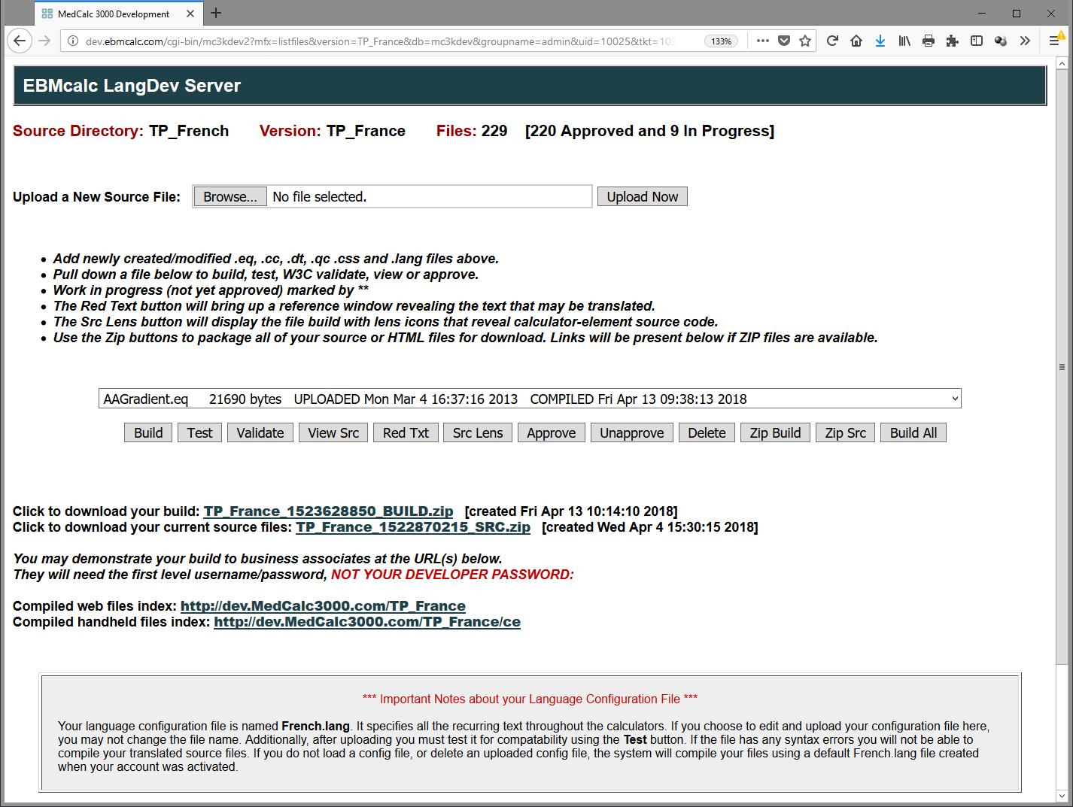
EBMcalc LangDev Server

Slide 8
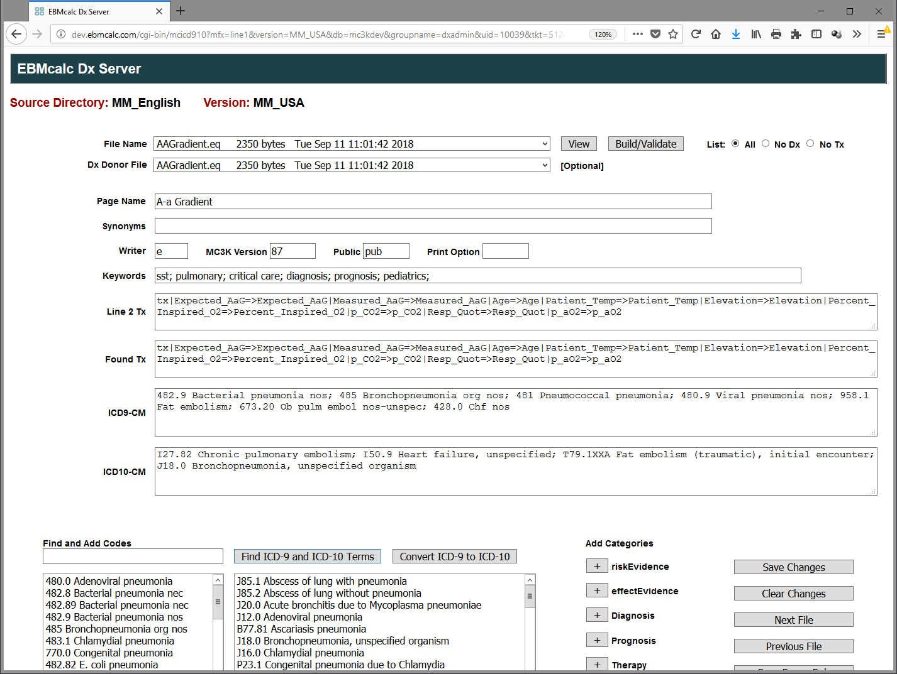
EBMcalc Dx Serverfor Meta Data Management

Slide 9
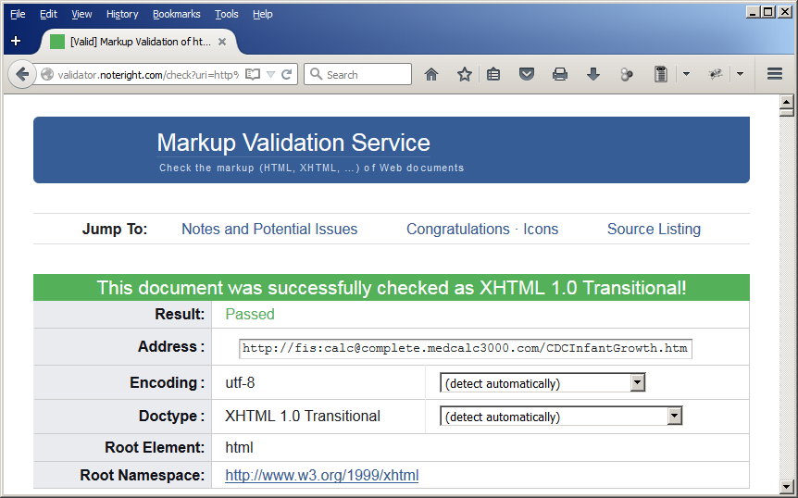
Calculator Testing
All calculator builds must pass formal W3C validation testing assuring syntactically correct HTML/XHTML standards.

Slide 10
Calculator Testing
All calculator literature references, ICD codes and MeSH terms are reviewed for accuracy by our medical director.
All external links to literature resources are tested for stability and accuracy (typically PubMed).
All LOINC codes used in EHR Connect calculators are internally validated though checksum algorithms, and externally validated by the review of code definitions at LOINC.org
Extensive manual testing is done on all new calculators, trying various combinations of valid and invalid user inputs.

Slide 11
Calculator Testing
Unit testing is accomplished using a combination of manual and automated tools.
Each new build that accepts coded and plain query string input data is accompanied by an on-screen collection of clickable URL’s with query strings representing multiple combinations of possible LOINC inputs (see next slide). Builders click these to assure correct data transfers.
Our custom automated unit testing app launches each calculator and posts numerous sets regular, irregular, and erroneous inputs from our database of manually verified calculator results. (following slide). Expected results are automatically confirmed and the Firebug JavaScript console monitors for any unexpected errors.

Slide 12
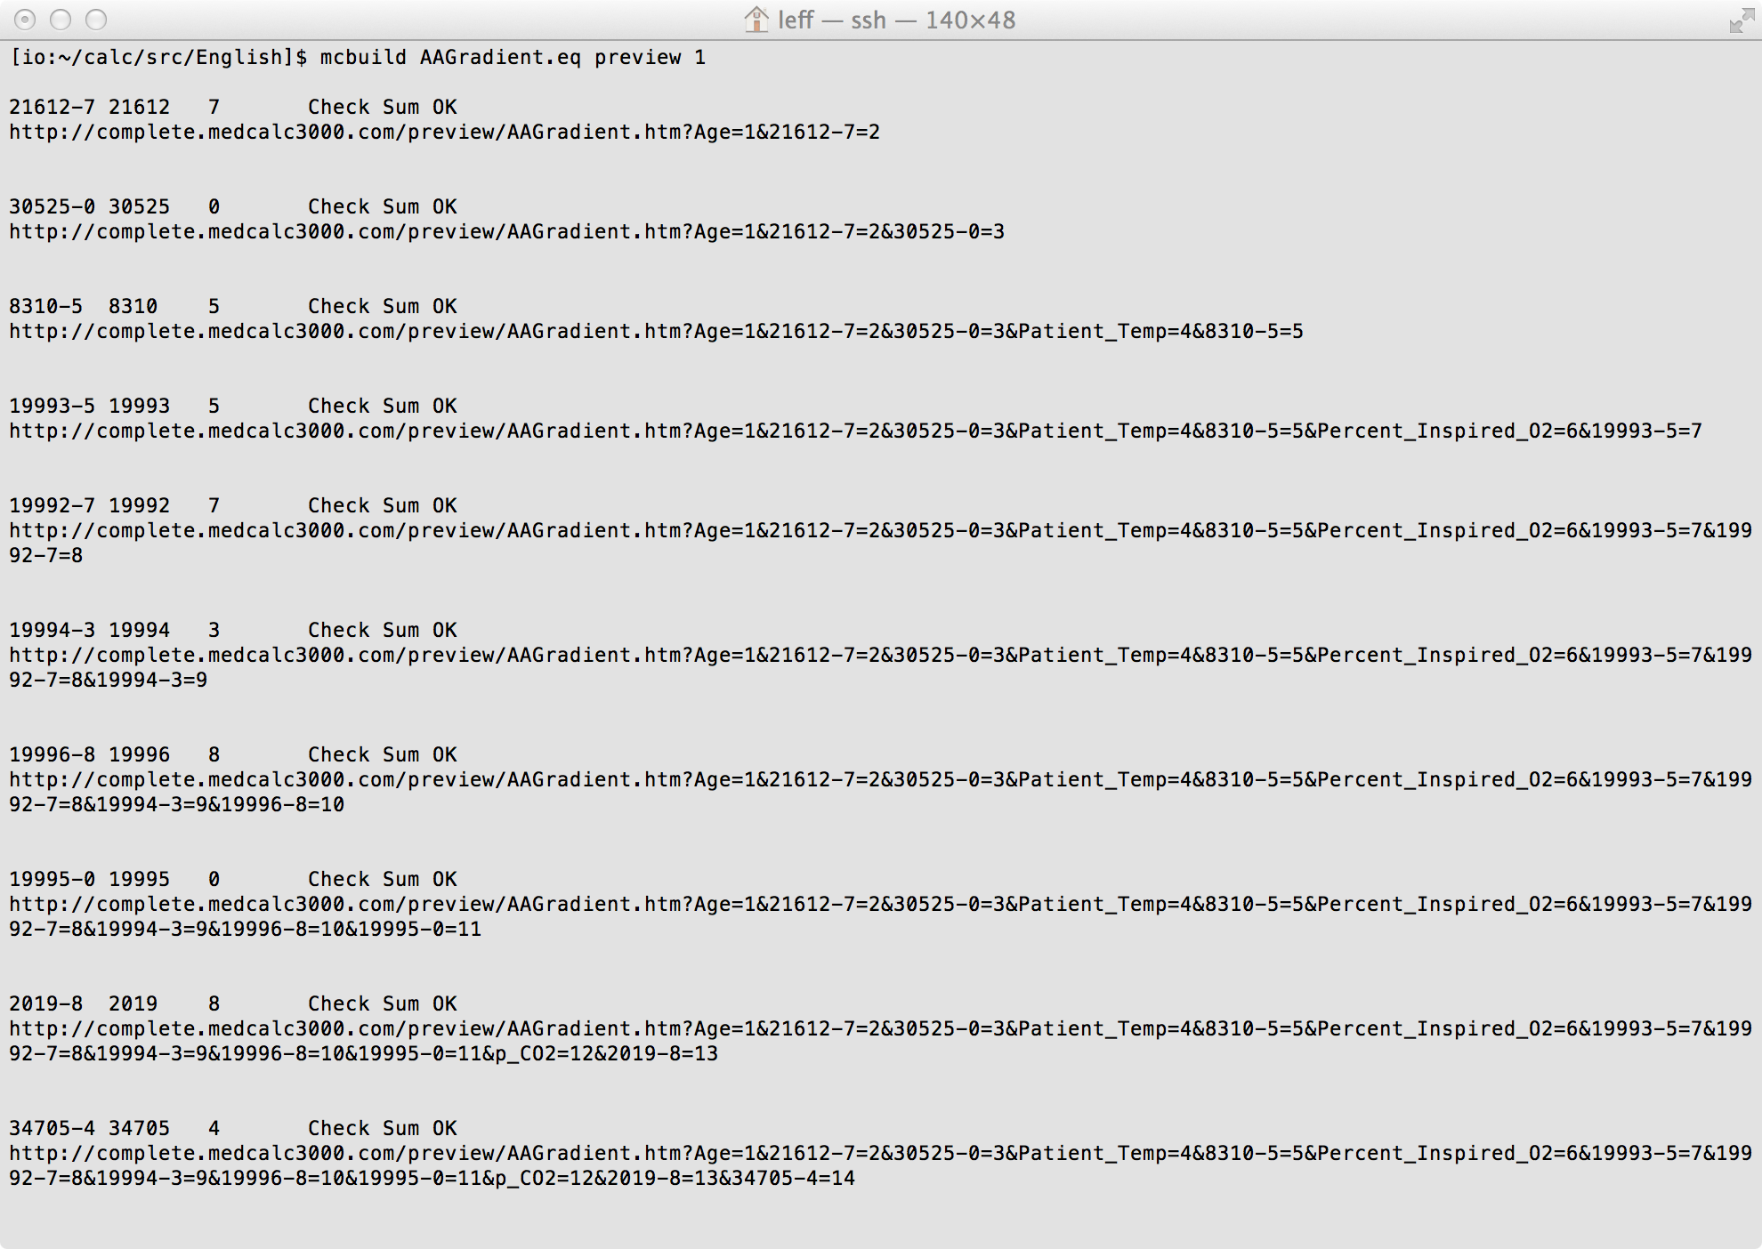
Calculator Testing (input and unit testing)

Slide 13

Calculator Testing
The majority of new calculators are suggested by our medical content partners.
Partners such as DynaMed (an EBSCO company) contribute expert literature review services as well as medical editor review of new calculators.
Partners such as Facts and Comparisons eAnswers, Clinical Pharmacology, and Lexicomp contribute testing and calculator validation by their staff pharmacologists (all Doctors of Pharmacology).
Partners such as UpToDate contribute addition testing and calculator validation by their staff of deputy editors (all MD’s) as well as their staff of programmers.

Slide 14
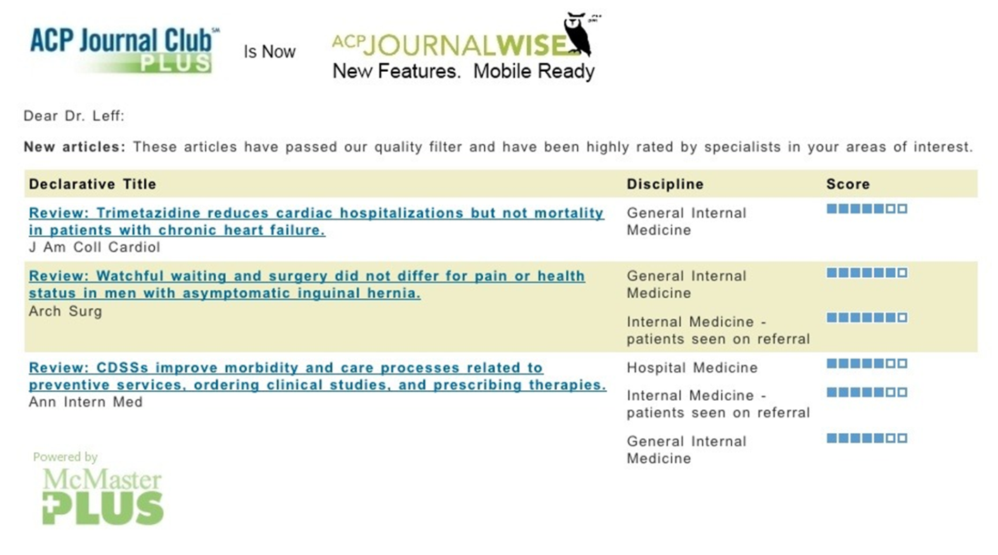
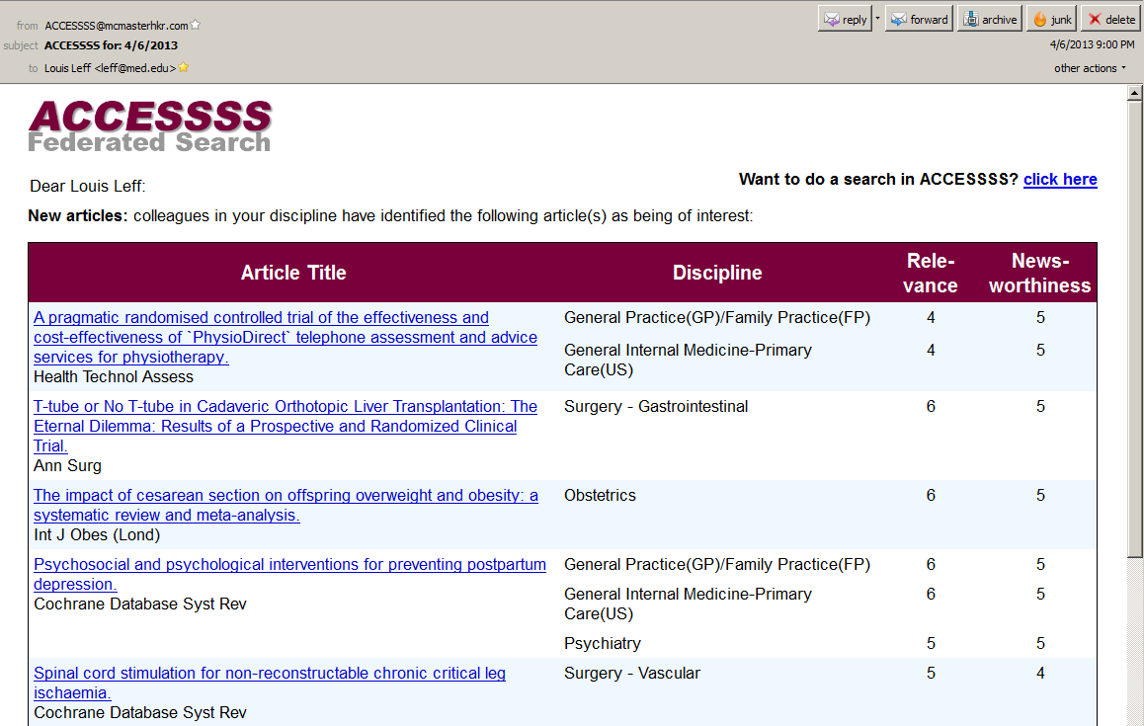
EBM Sources/Alerts Reviewed Every Day

Slide 15

Monitoring EBM Literature
EBMcalc RefBot is our proprietary custom-built app that queries the National Library of Medicine PubMed databases once weekly.
All journal articles referenced in EBMcalc are queried.
RefBot collects all posted updates, new MeSH terms and new citations.
Any erratum and corrections posted after publication are marked for medical director review.
RefBot notifies editorial staff to initiate manual review and potential calculator update.

Slide 16
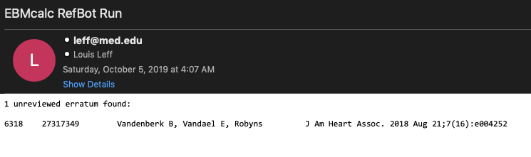
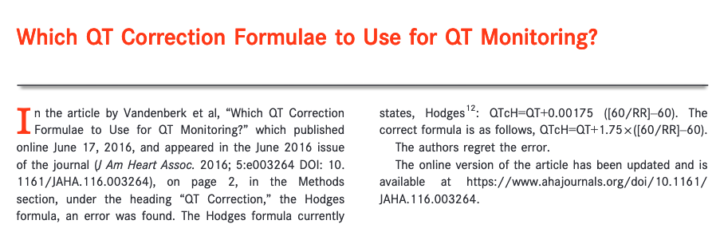
RefBot Discovery One Day After Adding Article

Slide 17
Calculator Update Process
Periodically new medical literature may suggest that a calculator must be updated or removed.
Some outdated calculators are maintained in the collection for historical reference. Examples are the original Gail models and Framingham calculators which give insight to how patients were treated when these calculators were in common use.
Rarely, an important update to an existing calculator is required. In these cases, we utilize our custom EBMcalc NotifyBot to build new versions for each partner, package and send them with personalized messages, and await return receipt emails.

Slide 18
EBMcalc Secret Sauce
Flexible FHIR® Build Configuration
cat|anthro|Vitals, Weights, Measures, and Graphs
bp|Blood pressure|55284-4|mmHg
a|Heart Rate|8867-4|beats/min
a|Height|8302-2|cm|Stature_For_Age
a|Weight|29463-7|kg|Weight_For_Age
a|Weight|3141-9|kg|Weight_For_Age
a|Body mass index|39156-5|ratio|BMI_For_Age
a|Head circumference|9843-4|cm|Head_Circ_For_Age
a|Head circumference|8287-5|cm|Head_Circ_For_Age
p1|Height mother|83846-6|cm
p1|Height father|83845-8|cm
end|cat
cat|cardio|Cardiovascular Calculators
c|Diabetes mellitus|Diabetes|Yes|No
hm|On hypertension med|On_Hypertension_Med|Yes|No
p|Total cholesterol|2093-3|mg/dL
p|Total cholesterol|14647-2|mmol/L
p|HDL cholesterol|2085-9|mg/dL
p|HDL cholesterol|14646-4|mmol/L

Slide 19
EBMcalc Secret Sauce: LOINC Maps
# Age/ Measurements / Vitals
###############################
Age<==>21612-7|Years old|21612-7|yr|21612-7|years|30525-0|Years old|30525-0|yr|30525-0|years
Wgt|Weight<==>29463-7|kg|3141-9|kg|8350-1|kg|8351-9|kg
Hgt|Height|Height_Potential|Length<==>8302-2|cm
Head_Circumference|Head_circumference<==>9843-4|cm|8287-5|cm|8288-3|cm|8290-9|cm|8291-7|cm
BMI|Body_Mass_Index<==>39156-5|kg/m^2|59576-9|kg/m^2
Height_Mother<==>83846-6|cm
Height_Father<==>83845-8|cm
Systolic_BP|Systolic_Blood_Pressure|Sys_BP|SBP<==>8480-6|mmHg
Diastolic_BP|Diastolic_Blood_Pressure|Dia_BP|DBP<==>8462-4|mmHg
Systolic_BP_Percentile<==>72165-4|%
Diastolic_BP_Percentile<==>72164-7|%
Patient_Temp|Temperature|Temp<==>8310-5|degC
HR|Heart_Rate<==>8867-4|beats/min
Respiratory_Rate|RR<==>9303-9|breaths/min|9279-1|breaths/min|76170-0|breaths/min|19840-8|breaths/min
Central_Venous_Pressure|CVP<==>60985-9|mmHg|8591-0|mmHg
Mean_Arterial_Pressure|MAP<==>8478-0|mmHg|8458-2|mmHg|76214-6|mmHg|75996-9|mmHg

Slide 20
EBMcalc Secret Sauce: Unit Conversion
q|Lab Conversions|units|87|pub
501|mg/dL_Bili|17.1|0
501|mg%_Bili|17.1|0
501|mcmol/L_Bili|1|0
502|mg/dL_Cr|88.4|0
502|mcmol/L_Cr|1|0
502|mmol/L_Cr|1000|0
503|mcg/mL_acet|6.62|0
503|mg/L_acet|6.62|0
503|mcmol/L_acet|1|0
504|mg/L_Amik|1.71|0
504|mcg/mL_Amik|1.71|0
504|mcmol/L_Amik|1|0
506|mg/L_Gent|2.09|0
506|mcg/mL_Gent|2.09|0
506|mcmol/L_Gent|1|0
507|mg/L_Tobra|2.14|0
507|mcg/mL_Tobra|2.14|0
507|mcmol/L_Tobra|1|0

Slide 21
EBMcalc Secret Sauce: Language Files
#
# EBMcalc
# SPANISH LANGUAGE INCLUDE FILE
# Copyright 1998-2018, EBMcalc, LLC
#
################# used in FBUILD ######################
$_HOME = "CASA";
$_ABOUT = "SOBRE";
$_LOINCCODES = "CÓDIGOS LOINC";
$_PRESSROOM = "SALA DE PRENSA";
$_ONCCRITERIA = "CRITERIOS ONC";
$_CalculatorCategory = "Categoría de calculadora";
$_Calculator = "Calculadora";
$_Data = "Datos";
$_Conditions = "Condiciones";
$_Medications = "Medicamentos";
$_Click = "Hacer clic";

